Slide 1
SILVER LAKE DRAINAGE IMPROVEMENTS PROJECT PUBLIC INFORMATION MEETING OCTOBER, 2018 New York State Governor’s Office of Storm Recovery (GOSR) – Funded Disaster Recovery
Project Team:

Slide 2
PROJECT PURPOSE
Identify Deficiencies in the Existing Drainage System of Silver Lake Park Located in Baldwin, NY
Identify Potential Design Solutions to Mitigate Flooding Issues to the Maximum Extent Feasible Within the Available Funding. (Funding = $2 Million Overall; Approximately $1.7 Million For Construction)
Identify Potential Design Solutions that Improve Water Quality and Address Ecological Issues (i.e. Fish Passage)
Prioritize Project’s Feasible Design Alternative Components from High Priority to Low Priority
Prepare 30% (Preliminary) Design Plans for Selected Priority Projects

Slide 3
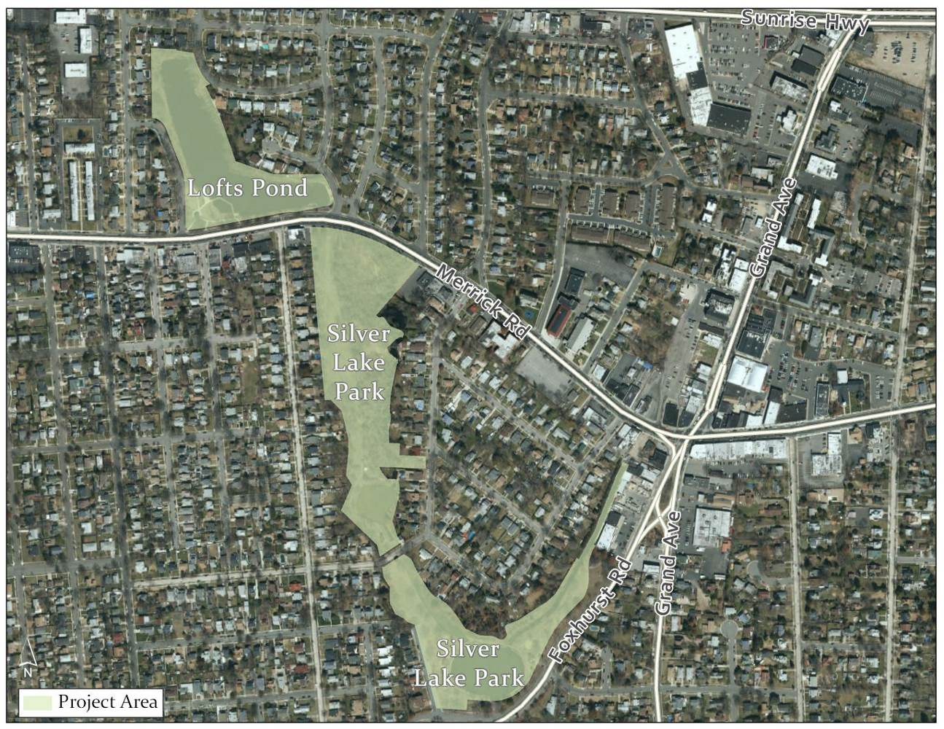
PROJECT STUDY AREA

Slide 4
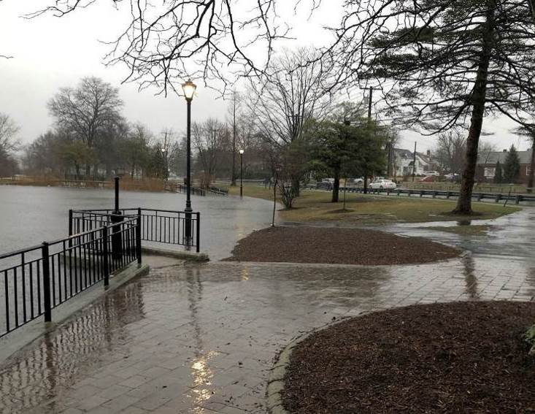
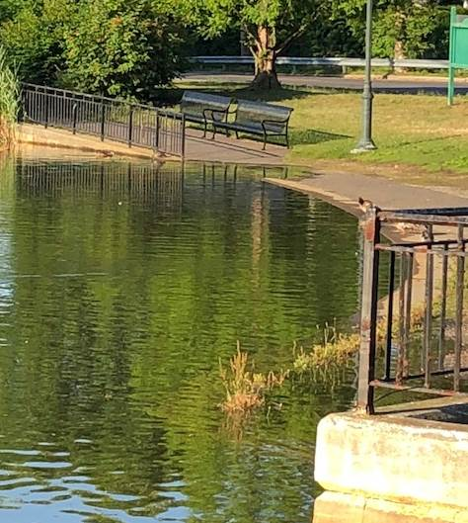
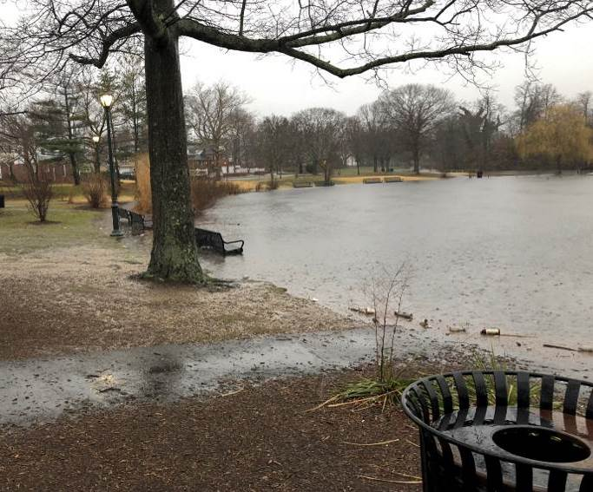
OBSERVED FLOODING
DURING STUDY PERIOD SIGNIFICANT FLOODING WAS OBSERVED ON MARCH 2, 2018. THIS WAS A 2.16” RAINFALL COMBINED WITH A TIDAL SURGE THAT REACHED 4.23’ (NAVD88) IN PARSONAGE CANAL
MINOR FLOODING WAS ALSO OBSERVED ON JULY 10, 2018. NO RAIN BUT A ELEVATED TIDE OF 3.12’ (NAVD88) OCCURRED.

Slide 5
PUBLIC OUTREACH
Public Outreach was a Key Aspect of the Study to Collect Local Knowledge of Park Issues Related to Drainage, Water Quality and Ecology
Four Outreach Meetings where held to solicit input on key flooding areas and feedback on potential solutions.
March 14, 2018 (Stakeholder Committee)
April 25, 2018 (Stakeholder Committee)
June 21, 2018 (Stakeholder Committee)
September 18, 2018 (Stakeholder Committee)
One Public Open House was Held on April 12, 2018
Several Alternatives Were Conceived or Presented at these Meetings!

Slide 6
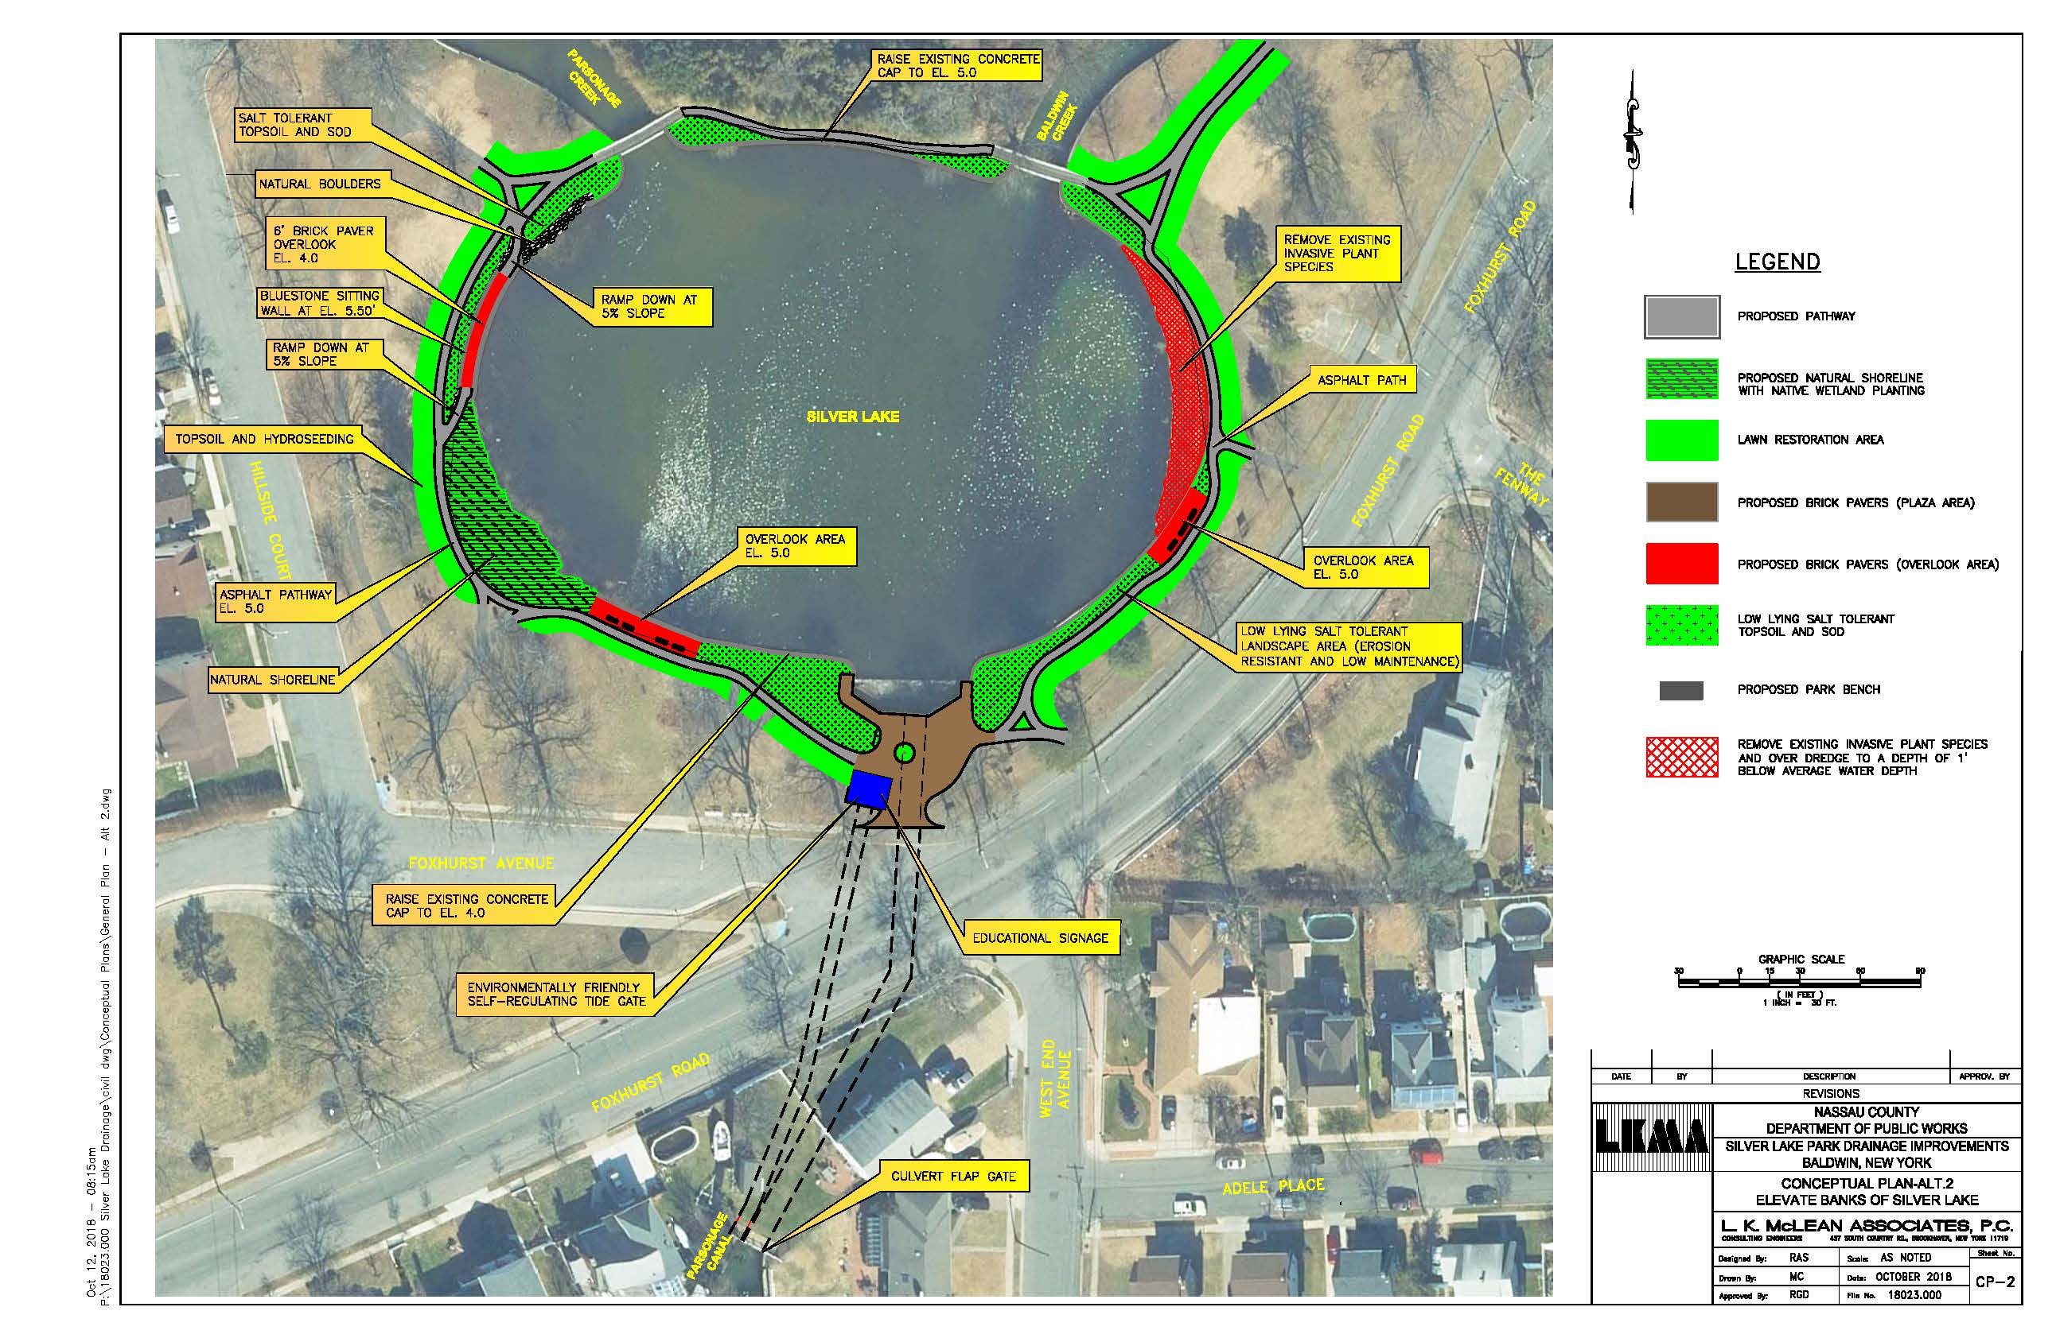
CONCEPTUAL PLAN

Slide 7
PROPOSED DESIGN COMPONENT 1
ELEVATE PERIMETER WALKWAY OF SILVER LAKE TO ELEVATION 5.0’ (NAVD88)

Slide 8
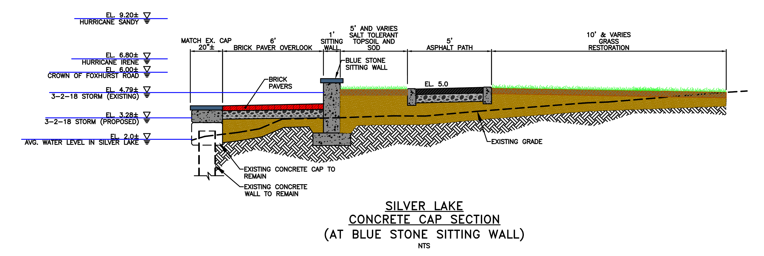
PROPOSED DESIGN COMPONENT 1
ELEVATE PERIMETER WALKWAY OF SILVER LAKE TO ELEVATION 5.0’ (NAVD88)

Slide 9
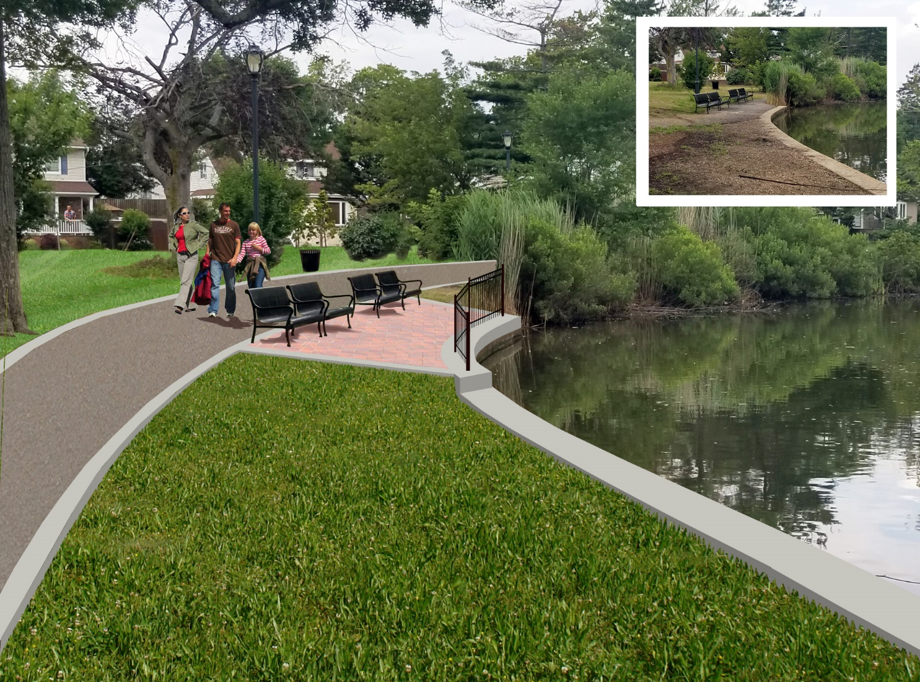
PROPOSED DESIGN COMPONENT 1 - CONT

Slide 10
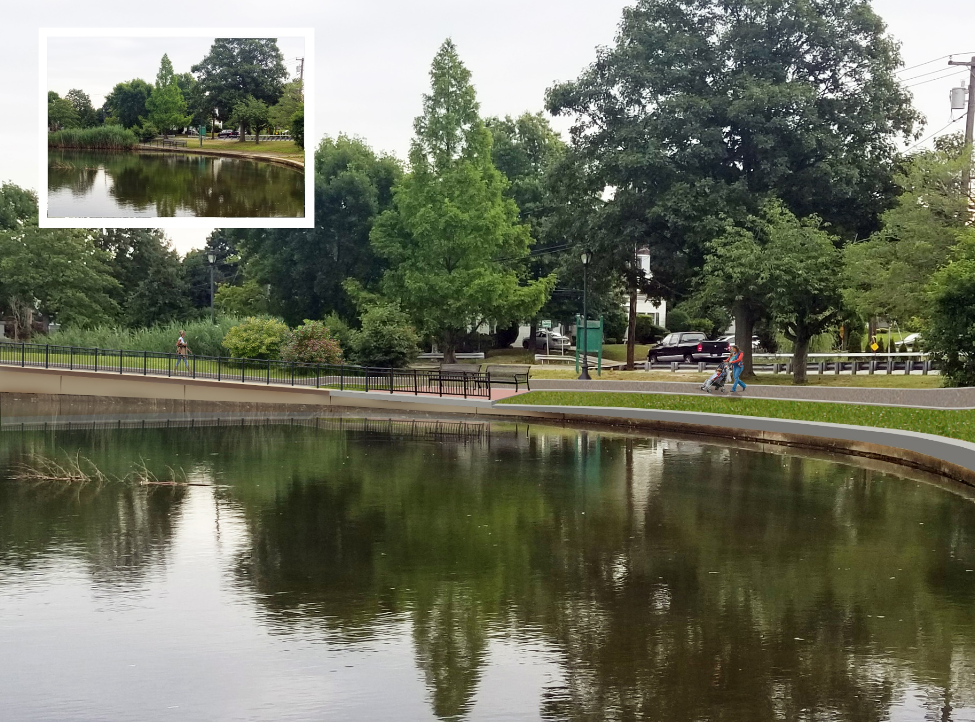
PROPOSED DESIGN COMPONENT 1 - CONT

Slide 11
PROPOSED DESIGN COMPONENT 1 - CONT

Slide 12
PROPOSED DESIGN COMPONENT 1 - CONT

Slide 13
BENEFITS OF RAISING PERIMETER WALKWAY DESIGN COMPONENT 1
WILL SIGNIFICANTLY REDUCE THE OCCURRENCE OF WALKWAY FLOODING
WILL MITIGATE FLOODING FOR UP TO A 10-YEAR RAINFALL (5.05”-24HOURS) WITH A NORMAL HIGH TIDE
WILL MITIGATE FLOODING IF A 1-YEAR RAINFALL (2.8”-24 HOURS) OCCURS SIMULTANEOUSLY WITH A 1-YEAR TIDE SURGE (EL=4.42’ NAVD88).

Slide 14
PROPOSED DESIGN COMPONENT 2
INSTALL TIDE GATES ON SILVER LAKE OUTFALLS
Benefits of Tide Gate:
Provides Flood Protection of
Silver Lake Park up to a 10-year Tide Surge in Dry Weather or Low Intensity Rainfall Conditions
MAINTAIN FISH PASSAGE WITH
ECOLOGICALLY FRIENDLY TIDE
GATE ON WESTERN 6’X6’ CULVERT

Slide 15
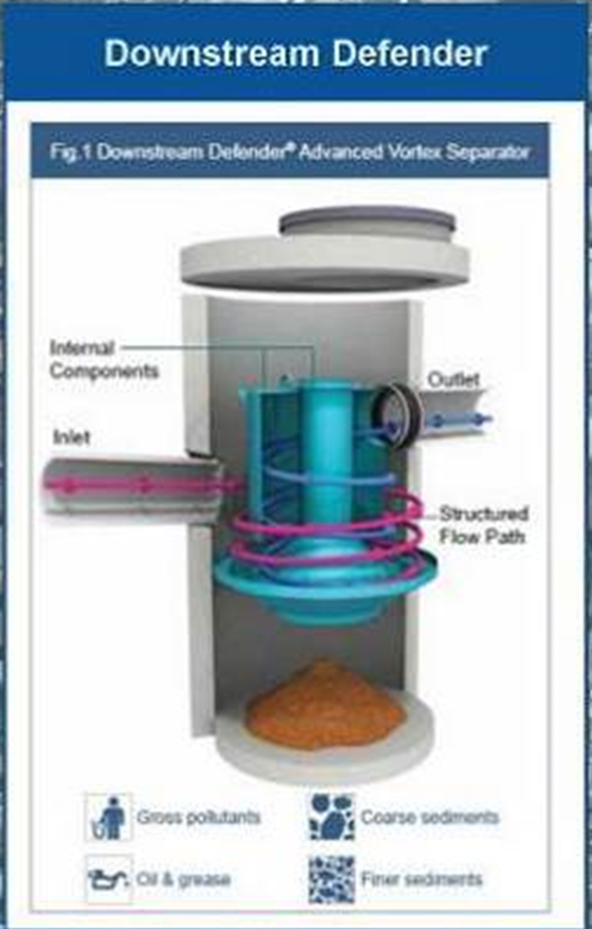
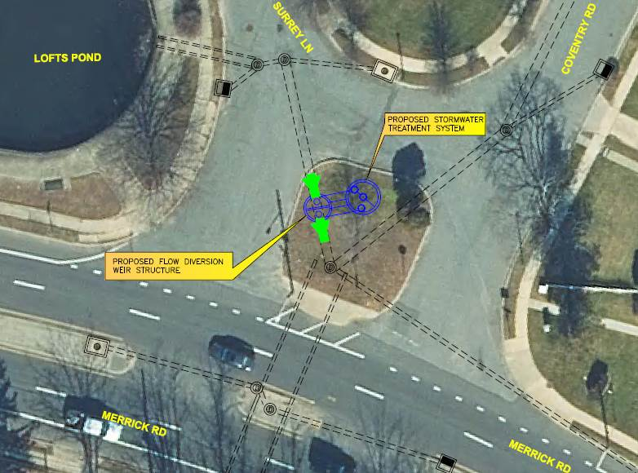
PROPOSED DESIGN COMPONENT 3
INSTALL STORMWATER TREATMENT DEVICE BETWEEN LOFTS POND AND NATURAL CHANNEL SOUTH OF MERRICK ROAD
BENEFITS: REMOVES FLOATABLES, SEDIMENT AND OILS FROM RUNOFF AND LOFTS POND OVERFLOW BEFORE IT ENTERS PARSONAGE CREEK.

Slide 16
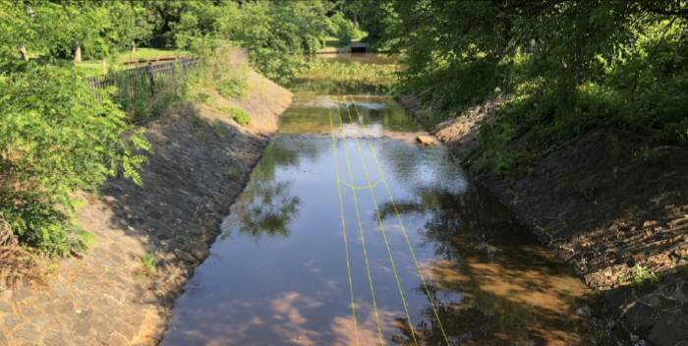
PROPOSED DESIGN COMPONENT 4
PROVIDE FISH PASSAGE TO CAROLINE’S POND BY CONSTRUCTING A LOW FLOW CHANNEL IN THE EXISTING TRAPEZOIDAL CHANNEL SOUTH OF THE POND

Slide 17
LOCAL STORM EVENTS WITHIN THE PAST 10 YEARS
Only the following storm events would have caused flooding with the proposed design:
3/13/10 (St. Patrick’s Day Nor’easter; Peak Tide Elevation 6.21 with 1.74” rainfall)
8/28/11 (Hurricane Irene)
8/14/11 (Historic Long Island Flash Flooding; 7.8” Rainfall)
10/29/12 (Superstorm Sandy)
1/10/16 (January 10th Rain and Wind Event; Peak Tide Elevation 5.20 with 1.28” rainfall)
It is notable that flooding was observed at Silver Lake on 3/2/18 during the study. The water surface elevation of Silver Lake reached Elevation 4.79. With the proposed design the water surface elevation would only reach Elevation 3.28.

Slide 18
BENEFITS OF DESIGN ALTERNATIVES
Raising the perimeter walkway elevation and the installation of tidal gates will significantly reduce the occurrence of flooding.
The design alternative will mitigate flooding at Silver Lake for a design scenario that includes a 1-year rainfall (2.8” 24-hour storm) peak intensity occurring simultaneously with a 1-year tailwater elevation (Elevation 4.42’ NAVD88).
The design alternative will mitigate flooding at Silver for a design scenario that includes a 10-year rainfall (5.3” 24-hour storm) peak intensity combined with a normal high tide of 2.62’ (NAVD88).
The installation of tide gates will significantly reduce the potential of flooding for Silver Lake and Caroline’s Pond from a tidal surge up to a 10-year Stillwater elevation during dry weather or low intensity rainfalls.

Slide 19
BENEFITS OF DESIGN ALTERNATIVES (cont)
The new walkways will replace the existing deteriorated asphalt walkways and address ADA / PROWAG compliance.
The overall aesthetics of Silver Lake Park will be significantly improved as a result of the new landscaped lake perimeter, overlooks and reconstructed walkway.
The proposed stormwater treatment device will reduce the amount of floatables, oils and sediment entering the Parsonage Creek natural channel south of Merrick Road.
Fish Passage will be maintained at Silver Lake and Created at Caroline’s Pond.

Slide 20
BENEFITS OF DESIGN ALTERNATIVES (cont)
The proposed fish passage south of Caroline’s Pond will increase the natural habitat for ecologically important fish species such as river herring (alewife).
Elevating the perimeter walkway around Silver Lake to elevation 5.0’ (NAVD) from its existing elevation of 3.0’ will help alleviate future issues that may occur as a result of potential sea-level rise. The NYSDEC has estimated that the Long Island Region can expect to be impacted by a rise in sea-level of approximately 8 inches to 30 inches by the 2050s.
The design will remove invasive plants at the existing natural shoreline areas and create sections of living shoreline with native plant species. This will improve the natural habitat of Silver Lake.

Slide 21
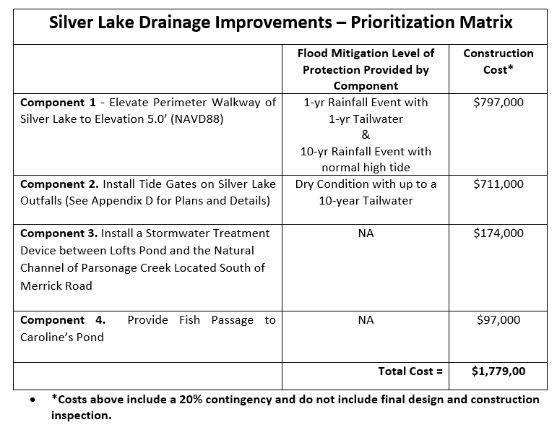
HIGH PRIORITY PROJECT COSTS

Slide 22
NEXT STEPS
30% PRELIMINARY DESIGN PROJECTS FUNDED AND CURRENTLY IN DESIGN PHASE
PROJECT IS ON SCHEDULE TO BE COMPLETED AT THE END OF NOVEMBER, 2018

Slide 23
QUESTIONS?
THIS PROJECT WAS FUNDED BY AND CONCEIVED THROUGH THE NY RISING COMMUNITY RECONSTRUCTION PROGRAM OF THE GOVERNOR’S OFFICE OF STORM RECOVERY.
FOR MORE INFORMATION CONTACT:
JOE CUOMO, PLANNING DIVISION, NASSAU COUNTY DEPT. OF PUBLIC WORKS, 1194 PROSPECT AVENUE WESTBURY, NY 11590
JCUOMO@NASSAUCOUNTYNY.GOV

Slide 24
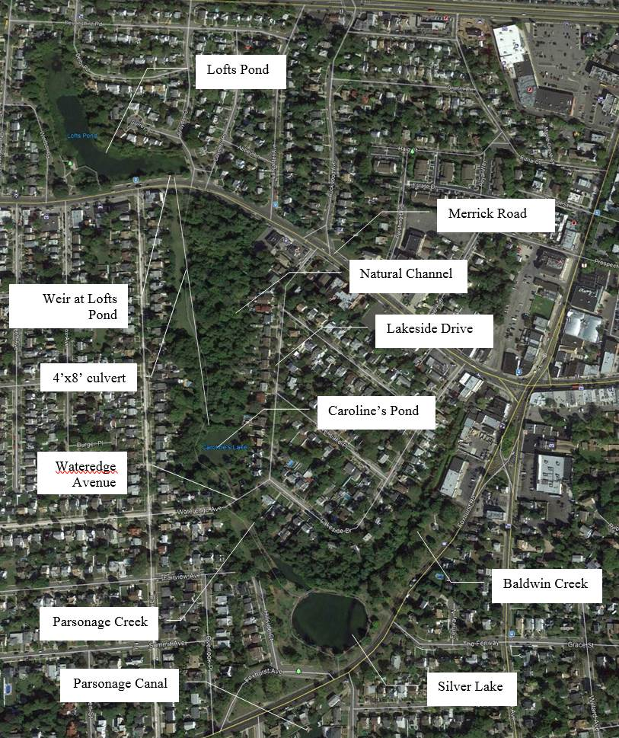
EXISTING HYDRAULIC SYSTEM INVESTIGATIONS GENERAL OVERVIEW

Slide 25
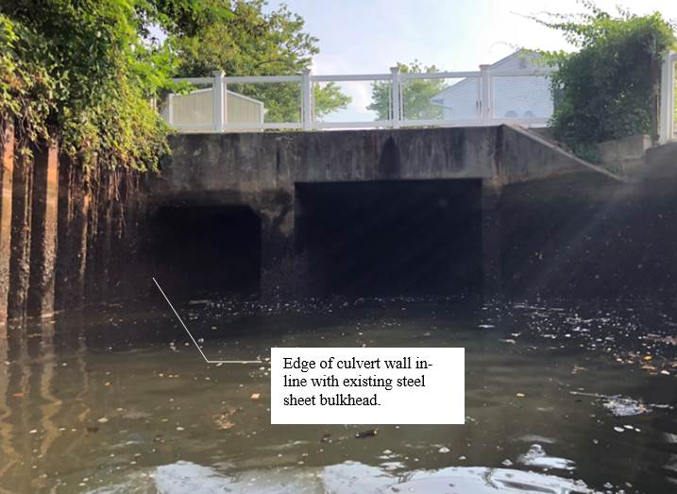
EXISTING HYDRAULIC SYSTEM INVESTIGATIONS OUTFALL CULVERTS
EXISTING CULVERT ARE:
6’X6’ BOX CULVERT (WEST)
7’-3” X 10’ BOX CULVERT EAST
NO TIDAL GATES EXIST
NO SPACE ON WEST CULVERT FOR TRADITIONAL TIDAL GATE

Slide 26
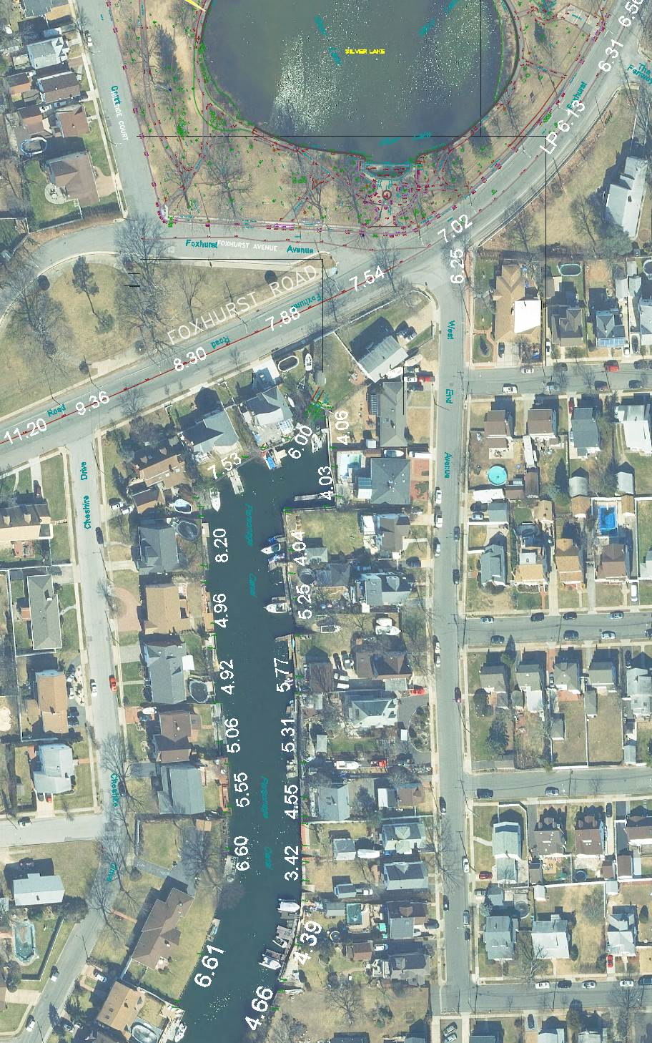
EXISTING HYDRAULIC SYSTEM INVESTIGATIONS PARSONAGE CANAL BULKHEAD ELEVATIONS
TYPICAL BULKHEAD ELEVATIONS ARE AROUND 4.0’ – 5.5’ (NAVD88)
TIDAL SURGES OVER ELEVATION 6.25’ (NAVD88) WILL OVERTOP BULKHEADS AND FLOW OVER FOXHURST ROAD INTO SILVERLAKE PARK
NOTABLE ELEVATIONS TO CONSIDER
10-YEAR STILLWATER = 6.4’
100-YEAR STILLWATER = 7.9’

Slide 27
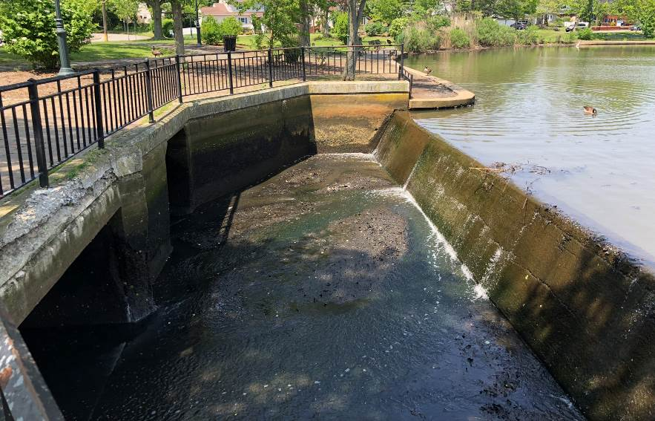
EXISTING HYDRAULIC SYSTEM INVESTIGATIONS SILVER LAKE WEIR
52’ WIDE AND IN GOOD CONDITION
IN 1980 WEIR WIDTH WAS INCREASED TO ACCOMMODATE WESTERN 6’X6’ CONCRETE CULVERT
ONLY 1’ OF FREEBOARD BETWEEN TOP OF WEIR AND TOP OF PERIMETER WALKWAY

Slide 28
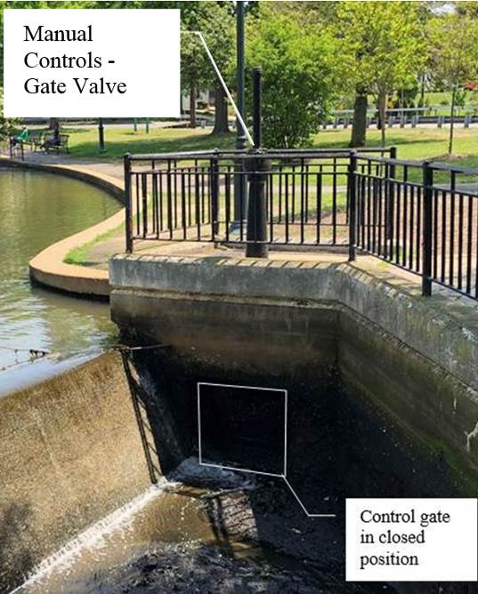
EXISTING HYDRAULIC SYSTEM INVESTIGATIONS CONTROL GATE AT WEIR
EXISTING CONTROL GATE ON EAST SIDE OF WEIR. SHOULD ALLOW THE LAKE TO BE DRAINED APPROXIMATELY 2’- 4’ FOR MAINTENANCE

Slide 29
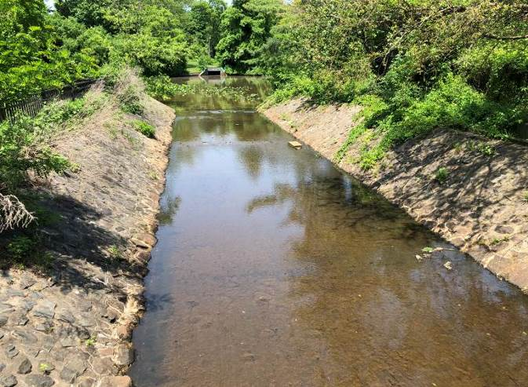
EXISTING HYDRAULIC SYSTEM INVESTIGATIONS UPSTREAM CHANNEL SOUTH OF CAROLINE’S POND
TRAPEZOIDAL CONCRETE CHANNEL SOUTH OF CAROLINE’S LAKE DOES NOT HAVE ENOUGH BASE FLOW DEPTH FOR FISH PASSAGE
CHANNEL CONTROLS ELEVATION OF CAROLINE’S POND

Slide 30
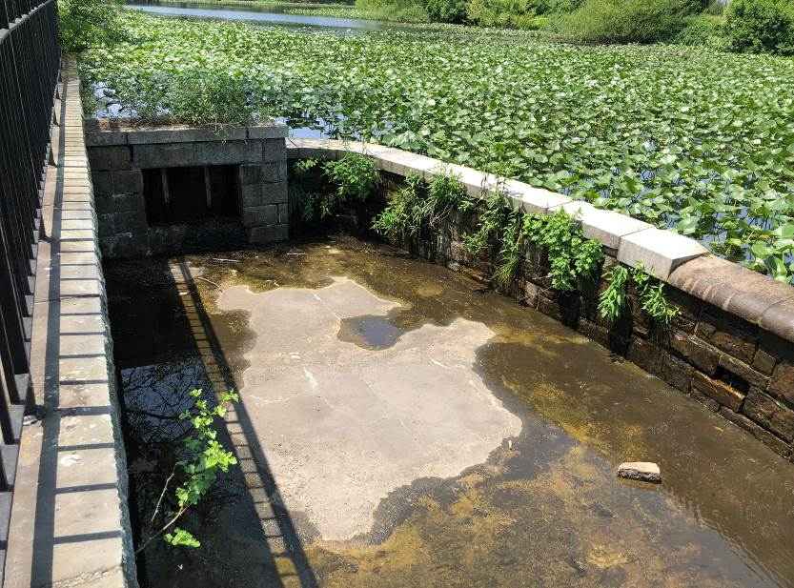
EXISTING HYDRAULIC SYSTEM INVESTIGATIONS WEIR STRUCTURE AT LOFT’S POND
LOFTS POND WEIR STRUCTURE ACTS AS A HIGH FLOW BYPASS DURING HEAVY RAINFALL EVENTS
A 30” PIPE ON THE EAST SIDE OF LOFT’S POND CARRIES BASE FLOW TO THE NATURAL CHANNEL BETWEEN MERRICK ROAD AND CAROLINE’S POND

Slide 31
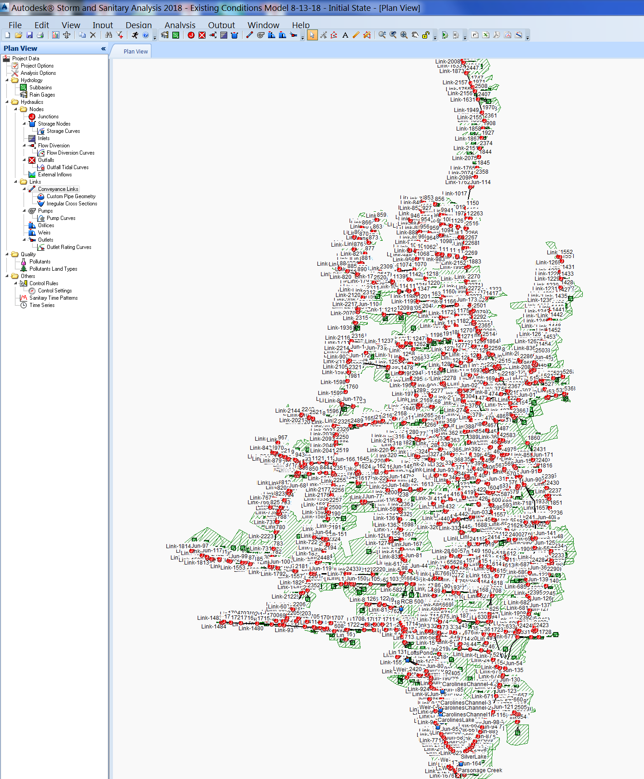
DRAINAGE MODEL
A DETAILED DRAINAGE MODEL WAS CREATED USING AUTODESK STORM & SANITARY ANALYSIS SOFTWARE

Slide 32
DESIGN SCENARIOS vs DESIGN CRITERIA
RAINFALL SYNTHETIC DESIGN STORMS EVALUATED
DRY WEATHER CONDITIONS = 0 INCHES
1 YEAR RAINFALL = 2.8 INCHES
10 YEAR RAINFALL = 5.3 INCHES
100 YEAR RAINFALL = 8.28 INCHES
TAILWATER ELEVATIONS (NAVD88)
MEAN TIDE CYCLE = 2.68’ MAX
1-YEAR TIDAL CYCLE = 4.42’ MAX
FOXHURST ROAD LOW POINT ELEVATION = 5.9’ MAX
10-YEAR STILLWATER = 6.4’ MAX
GOAL OF DESIGNS IS TO PROVIDE THE MAXIMUM FLOODING PROTECTION WITHIN THE AVAILABLE CONSTRUCTION FUNDS ($1.7 MILLION)

Slide 33
SIGNIFICANT FINDINGS OF EXISTING MODEL
SILVER LAKE WEIR CAPACITY IS INADEQUATE TO PASS A 10-YEAR RAINFALL EVENT WITHOUT CAUSING APPROXIMATELY 1.5 FEET OF FLOODING AROUND PERIMETER OF LAKE
SILVER LAKE OUTFALL CAPACITY IS INADEQUATE TO PASS A 10-YEAR RAINFALL WITHOUT CAUSING FLOODING AROUND PERIMETER OF LAKE
A 1-YEAR RAINFALL COMBINED WITH A 1-YEAR TAILWATER CONDITION WILL RESULT IN APPROXIMATELY 2 FEET OF FLOODING AT SILVER LAKE
A 10-YEAR STILLWATER TAILWATER CONDITION WILL RESULT IN APPROXIMATELY 3 FEET OF FLOODING AT SILVER LAKE
BOTH RAINFALL AND TIDAL SURGES CAN ALONE CAN CAUSE FLOODING OF SILVER LAKE AND CAROLINE’S POND
WHEN THESE OCCUR SIMULTANEOUSLY THE FLOODING CONDITION IS EXACERBATED.

Slide 34
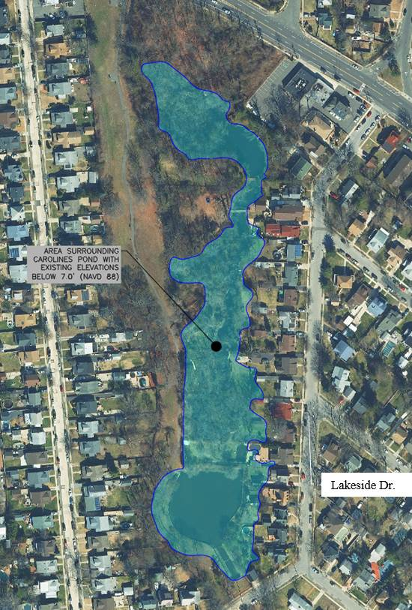
SIGNIFICANT FINDINGS OF EXISTING MODEL
A 10-YEAR RAINFALL OR A 10-YEAR TIDAL SURGE CAN ELEVATE THE SURFACE WATERS OF CAROLINE’S POND TO APPROXIMATELY ELEVATIONS 7.0’ (NAVD)
THIS ELEVATION WOULD FLOOD SOME OF THE RESIDENTIAL BACK YARDS OF THE HOMES ON LAKESIDE DR. THIS IS CONSISTENT WITH REPORTS FROM RESIDENTS AT THE PUBLIC MEETING.
NOTE THAT A 100-YEAR STILLWATER ELEVATION IS ELEVATION 7.9’ AND FLOODING UP TO THAT ELEVATION CAN BE EXPECTED IF THAT OCCURS

Slide 35
PROPOSED MODEL RESULTS SILVER LAKE

Slide 36
PROPOSED MODEL RESULTS CAROLINE’S POND

Slide 37
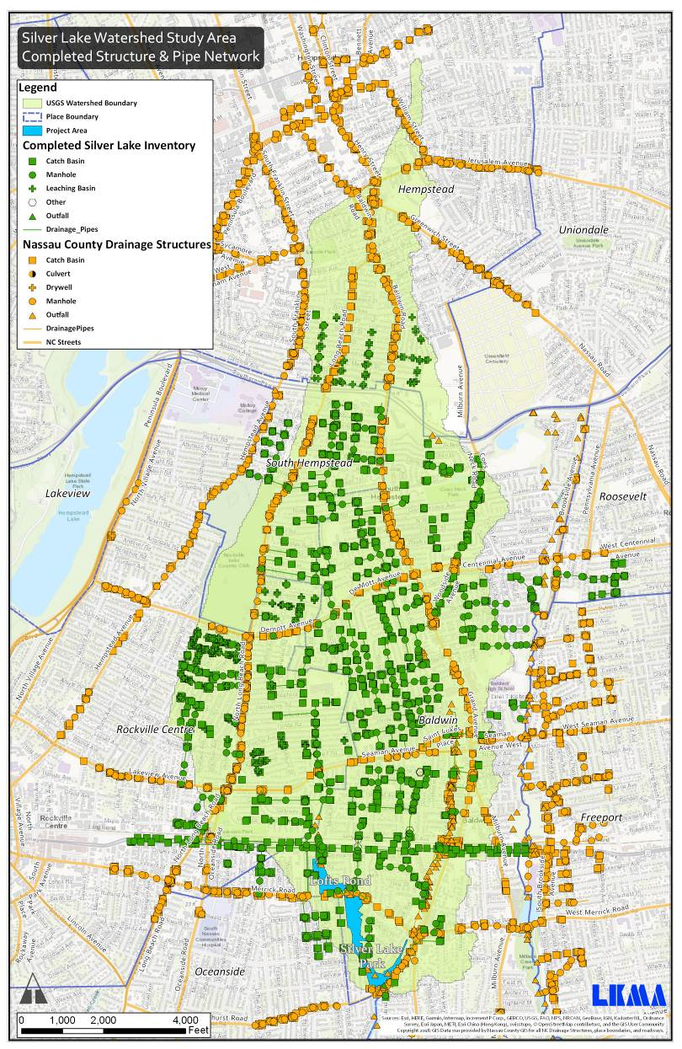
Silver Lake GIS Inventory
All Drainage Systems Contributing Runoff to Silver Lake Were Identified, Mapped and Documented in a GIS Inventory
Information Collected Via Record Plan, Field Investigations, GIS, and Survey.
Information Collected Includes:
Type of Structure
Location Coordinates
Approximate Rim Elevations
Pipe Inverts, Size and Material

Slide 38
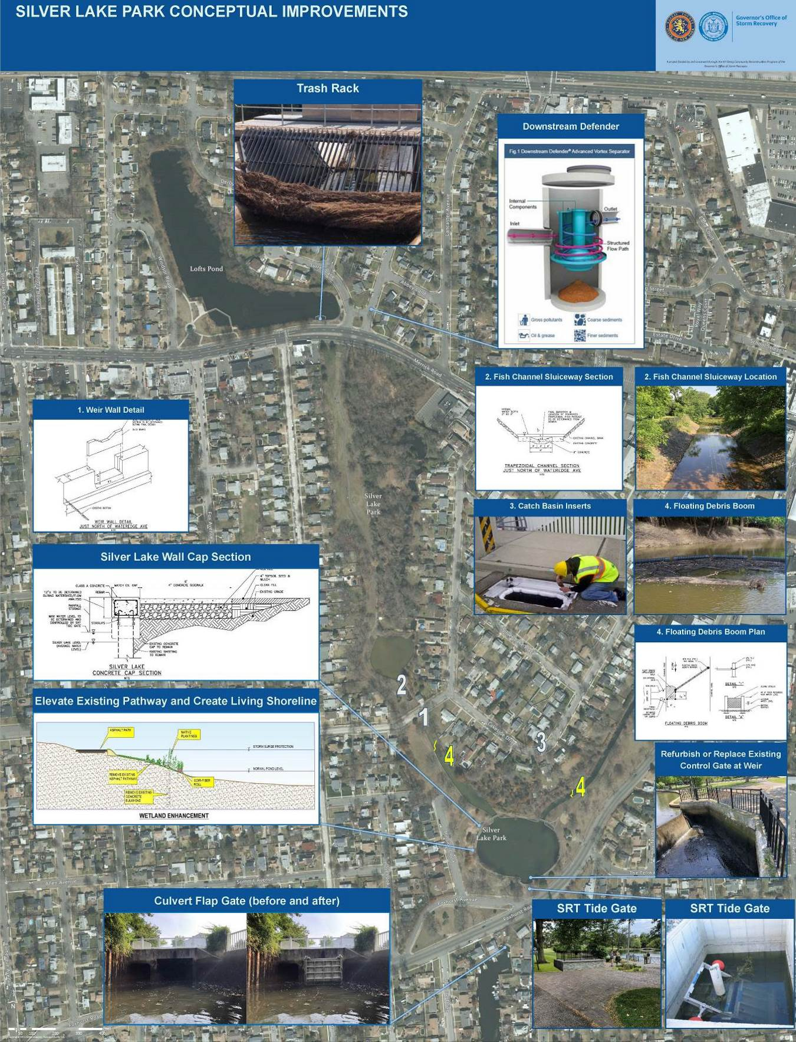
Stakeholder Committee- Alternatives Discussed
Tide Gates at Outlet Culverts
Elevating Perimeter of Silver Lake
Upstream Hydrodynamic Separation Units
Floating Debris Boom on Parsonage Creek & Baldwin Creek
Fish Passage at Silver Lake & Caroline’s Pond
Catch Basin Inserts
Trash Rack at Loft’s Pond

Slide 39
Establishing a DESIGN CRITERIA
DESIGN RAINFALL
10 Year (5.05 INCH 24-HOUR RAINFALL)
DESIGN TAILWATER
The design tailwater for this project is equal to the highest annual tidal cycle from Sandy Hook, NJ. The maximum elevation of the highest tide cycle was recorded as elevation 4.42.
**The highest tide of the design tidal cycle was synchronized with the peak intensity of the 24-hour rainfall event to simulate coincident heavy rainfall & tidal storm scenario.

Slide 40
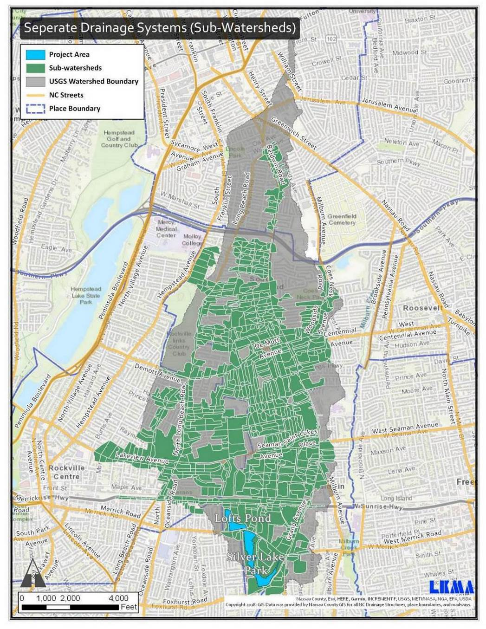
Silver Lake Watershed
Watershed is 2,675 Acres
With 997 identified Sub-Watersheds
Extends North of Southern State Parkway

